Slide 1
.Net Programming
Ngo Lam Trung
School of Information and Communication Technology
Office: 505-B1
E-mail: trungnl@soict.hust.edu.vn

Slide 2
Week 2: Base Types
Common Type System
.Net Base Types
Type conversion
Formatting types
Manipulating strings

Slide 3
Common Type System
Defines how types are declared, used, and managed in CLR
  A library of primitive data types
  Cross-platform, cross-language
  Strongly typed, object oriented

Slide 4
Common Type System
Classes
Structures
Enumerations
Interfaces
Delegates

Slide 5
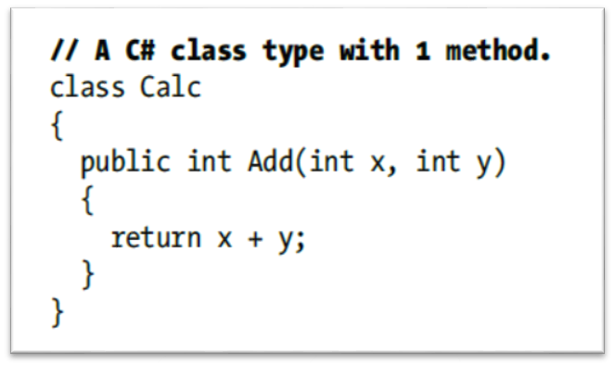
classes
Reference type, defines the operations that an object can perform (methods, events, or properties) and the data that the object contains (fields)
→ class in OOP

Slide 6
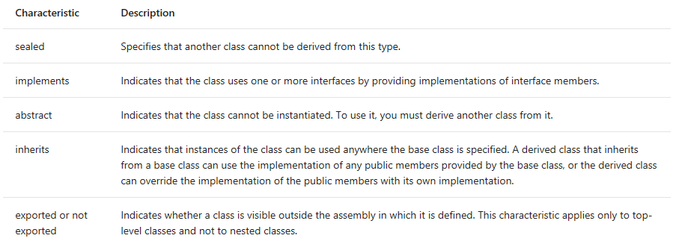
Classes
Class characteristics

Slide 7
Structures
Value type, similar to struct in C
Contain multiple data fields and methods executed on them
struct Point
{
// Fields of the structure
public int X;
public int Y;
// Add 1 to the (X, Y).
public void Increment()
{
X++; Y++;
}
// Subtract 1 from the (X, Y).
public void Decrement()
{
X--; Y--;
}
}

Slide 8
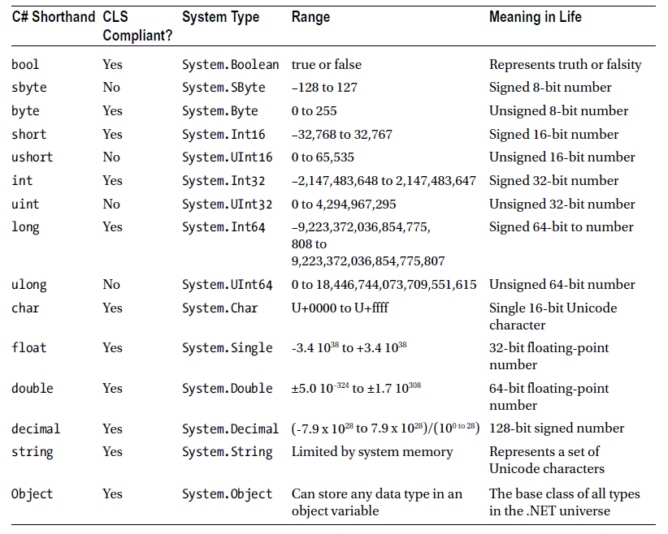
Common Type System
Note: All primitive types are structures
Primitive types are actually structures

Slide 9
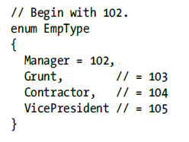
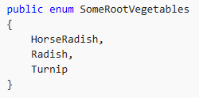
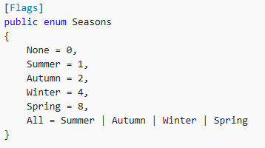
Enumeration (enum)
Value type, provides a set of name-value pairs
Value must be integer
Flags used for bit-field

Slide 10
Interface
Provides a list of abstract members: properties, methods, and events
  Interface members must all have public accessibility.
  Interfaces cannot define constructors.
  Interfaces cannot define fields.
  Interfaces can define only instance members. They cannot define static members.
  Interface name starts with I…

Slide 11

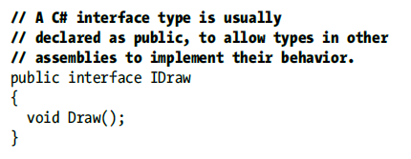
Interface

Slide 12
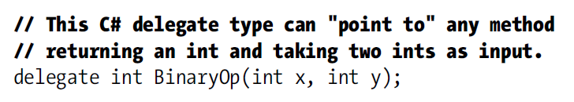
Delegates
Reference type, similar to function pointers in C/C++
Delegate is a “class”
Used for event handlers, callback functions

Slide 13
Type definition
Attributes:
Accessibility: public/assembly
The type's name: Unicode string
Base type: the base class inherited
Interfaces: any interface implemented.
Type's members.

Slide 14
using System;
public class Constants
{
public const double Pi = 3.1416;
public readonly DateTime BirthDate;
public Constants(DateTime birthDate)
{
this.BirthDate = birthDate;
}
}
public class Example
{
public static void Main()
{
Constants con = new Constants(new DateTime(1974, 8, 18));
Console.Write(Constants.Pi + "\n");
Console.Write(con.BirthDate.ToString("d") + "\n");
}
}
// The example displays the following output if run on a system whose
// current culture is en-US:
// 3.1416
// 8/18/1974

Slide 15
Type conversion
Convert a value from old type to new type
Widening-conversion: new type is larger then old type → no data loss, casting operator not required
Narrowing-conversion: possible data lost or incorrect value, casting operator required, check/unchecked conversion should be defined

Slide 16
Widening conversion
byte byteValue = 16;
short shortValue = -1024;
int intValue = -1034000;
long longValue = 1152921504606846976;
ulong ulongValue = UInt64.MaxValue;
decimal decimalValue;
decimalValue = byteValue;
decimalValue = shortValue;
decimalValue = intValue;
decimalValue = longValue;
decimalValue = ulongValue;
// After assigning a Byte value, the Decimal value is 16.
// After assigning a Int16 value, the Decimal value is -1024.
// After assigning a Int32 value, the Decimal value is -1034000.
// After assigning a Int64 value, the Decimal value is 1152921504606846976.
// After assigning a Int64 value, the Decimal value is 18446744073709551615.

Slide 17
Narrowing conversion
Convert and round/truncate the value of old type to the nearest value of new type
check: do range checking and throw exception if overflow happens
uncheck (default): skip range checking → possible incorrect result

Slide 18
int largeValue = Int32.MaxValue;
byte newValue;
try {
newValue = unchecked((byte) largeValue);
Console.WriteLine("Converted the {0} value {1} to the {2} value {3}.",
largeValue.GetType().Name, largeValue,
newValue.GetType().Name, newValue);
}
catch (OverflowException) {
Console.WriteLine("{0} is outside the range of the Byte data type.",
largeValue);
}
try {
newValue = checked((byte) largeValue);
Console.WriteLine("Converted the {0} value {1} to the {2} value {3}.",
largeValue.GetType().Name, largeValue,
newValue.GetType().Name, newValue);
}
catch (OverflowException) {
Console.WriteLine("{0} is outside the range of the Byte data type.",
largeValue);
}
// The example displays the following output:
// Converted the Int32 value 2147483647 to the Byte value 255.
// 2147483647 is outside the range of the Byte data type.

Slide 19
Reference type conversion
Implicit
  Conversion from a derived class to a base class
  Conversion from a type that implements an interface to an interface object
Explicit (require casting)
  Conversion from a base class back to the original derived class.
  Conversion from an interface object back to the original type that implements that interface.

Slide 20
Formatting types
Converting a value from original type to string representation
ToString() method:
  Default: return object name type for reference type, and object value for value type.
  Can be overridden
  Return value may change with format specifier

Slide 21
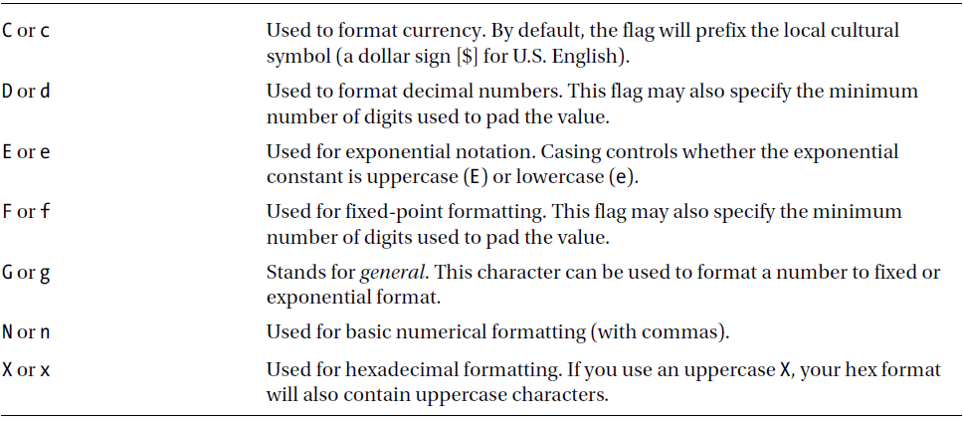
Formatting types
Numerical format specifiers
https://docs.microsoft.com/en-us/dotnet/standard/base-types/standard-numeric-format-strings

Slide 22
Formatting DateTime
Format specifier | Description
"d" | Short date pattern.
"D" | Long date pattern.
"f" | Full date/time pattern (short time).
"F" | Full date/time pattern (long time).
"g" | General date/time pattern (short time).
"G" | General date/time pattern (long time).
"M", "m" | Month/day pattern.
"O", "o" | Round-trip date/time pattern.
"R", "r" | RFC1123 pattern.
"s" | Sortable date/time pattern.
"t" | Short time pattern.
"T" | Long time pattern.
"u" | Universal sortable date/time pattern.
"U" | Universal full date/time pattern.
"Y", "y" | Year month pattern.
Any other single character | Unknown specifier.
https://docs.microsoft.com/en-us/dotnet/standard/base-types/standard-date-and-time-format-strings

Slide 23
Formatting DateTime
// Display using pt-BR culture's short date format DateTime thisDate = new DateTime(2008, 3, 15);
CultureInfo culture = new CultureInfo("pt-BR"); Console.WriteLine(thisDate.ToString("d", culture));
// Displays 15/3/2008

Slide 24
Parsing string
Convert string value into corresponding type value
Numerical type: using Parse and TryParse, together with culture info if necessary

Slide 25
Parsing string
string[] values = { "1,304.16", "$1,456.78", "1,094", "152",
"123,45 €", "1 304,16", "Ae9f" };
double number;
CultureInfo culture = null;
foreach (string value in values) {
try {
culture = CultureInfo.CreateSpecificCulture("en-US");
number = Double.Parse(value, culture);
Console.WriteLine("{0}: {1} --> {2}", culture.Name, value, number);
}
catch (FormatException) {
Console.WriteLine("{0}: Unable to parse '{1}'.",
culture.Name, value);
culture = CultureInfo.CreateSpecificCulture("fr-FR");
try {
number = Double.Parse(value, culture);
Console.WriteLine("{0}: {1} --> {2}", culture.Name, value, number);
}
catch (FormatException) {
Console.WriteLine("{0}: Unable to parse '{1}'.",
culture.Name, value);
}
}
Console.WriteLine();
}

Slide 26
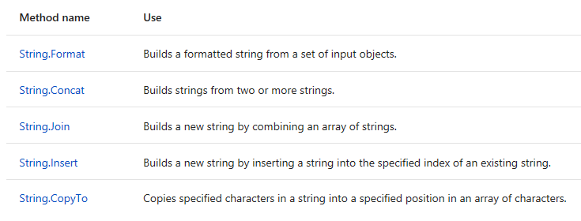
Working with String data
String: large amount of text stored in memory
String manipulation: create, compare, modify, parse, search for, remove, and replace text patterns.
Creating new string

Slide 27
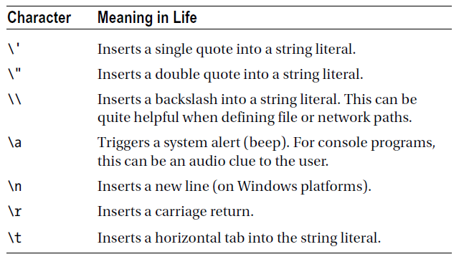
Escape characters
Notes: verbatim string with “@”

Slide 28
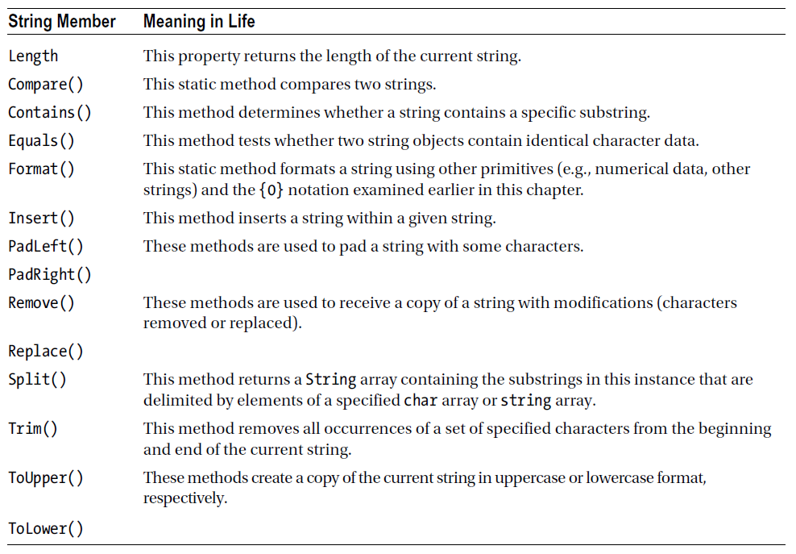
String manipulation

Slide 29
StringBuilder
Efficient concatenation and processing
Methods works on internal character storage

Slide 30
String interpolation
Easier string creation
// Some local variables we will plug into our larger string
int age = 4;
string name = "Soren";
// Using curly bracket syntax.
string greeting = string.Format("Hello {0} you are {1} years old.", name, age);
// Using string interpolation
string greeting2 = $"Hello {name} you are {age} years old.";
string greeting3 = string.Format("Hello {0} you are {1} years old.", name.ToUpper(), age);
string greeting4 = $"Hello {name.ToUpper()} you are {age} years old.";

Slide 31
Topic for next class
Regular Expression

